Slide 1


Marketing Insights & Analytics
Date: {{date}}

Slide 2

Analytics & Insights

Slide 3
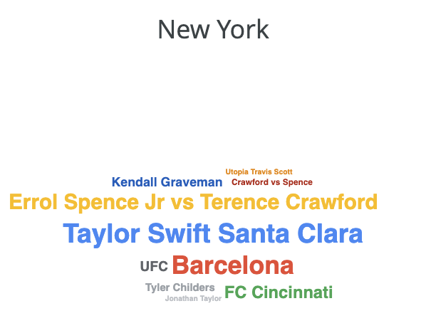
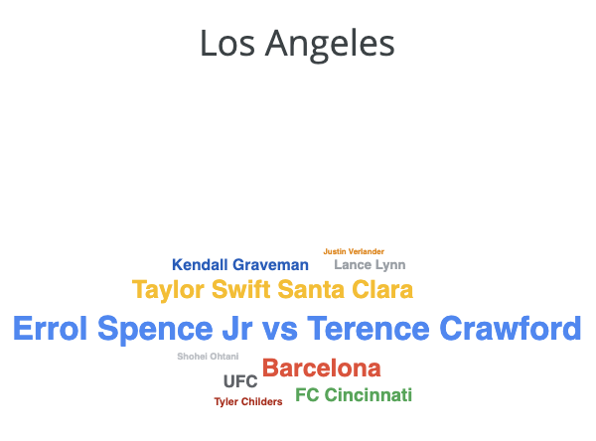
Trends & Consumer Insights
Top Terms

Slide 4
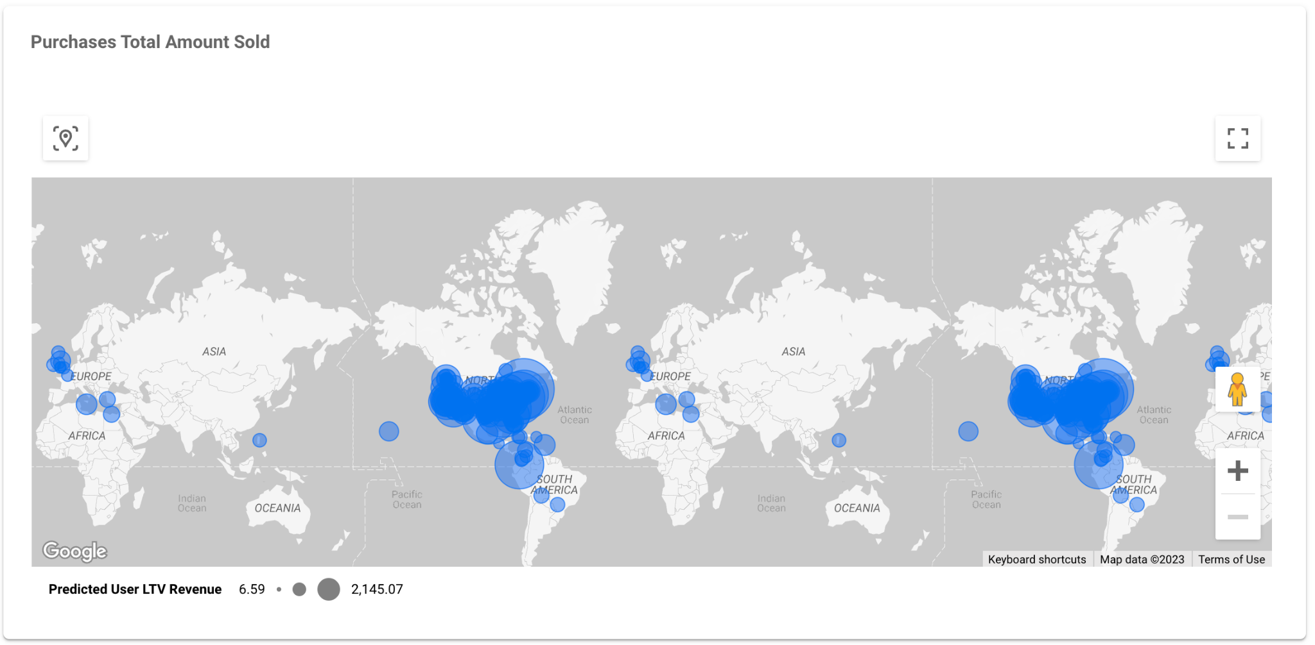
Audience insights
Predicted User LTV Revenue
Purchases Total Amount Sold

Slide 5
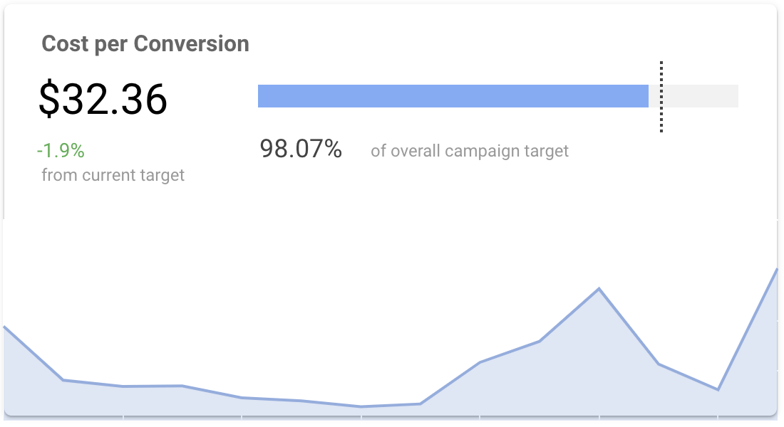
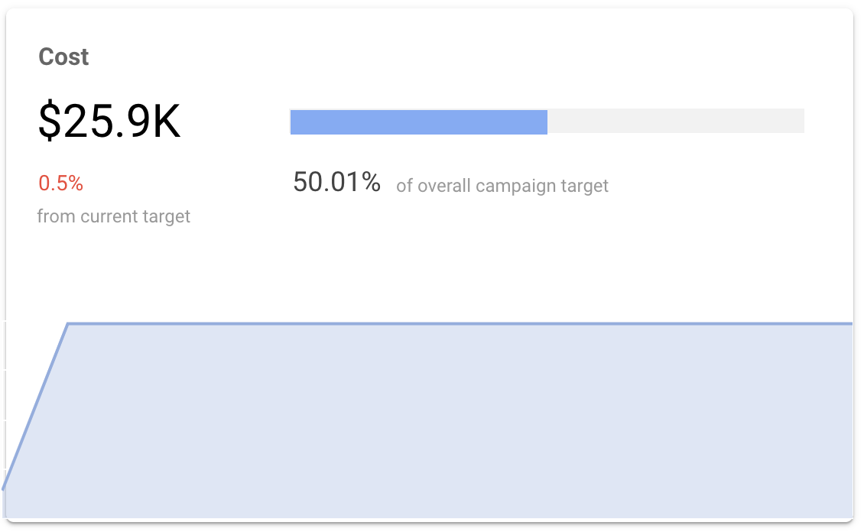
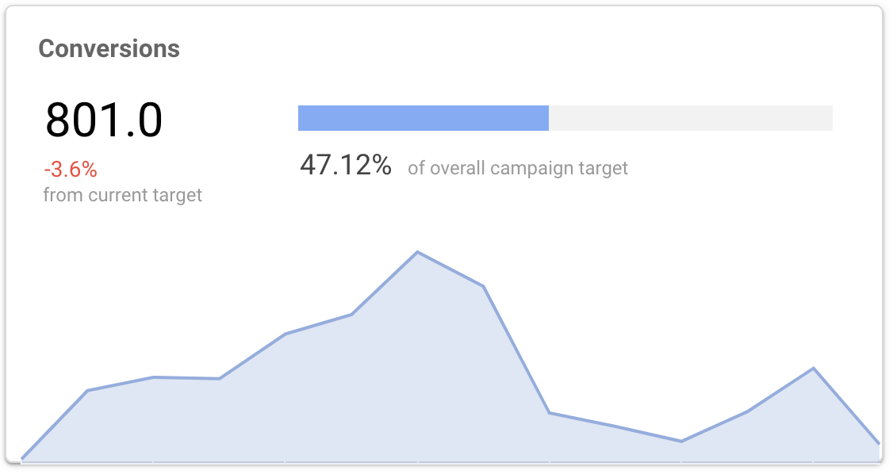
Campaign performance
Conversions
Cost per conversion
Conversion trends
Cost

Slide 6
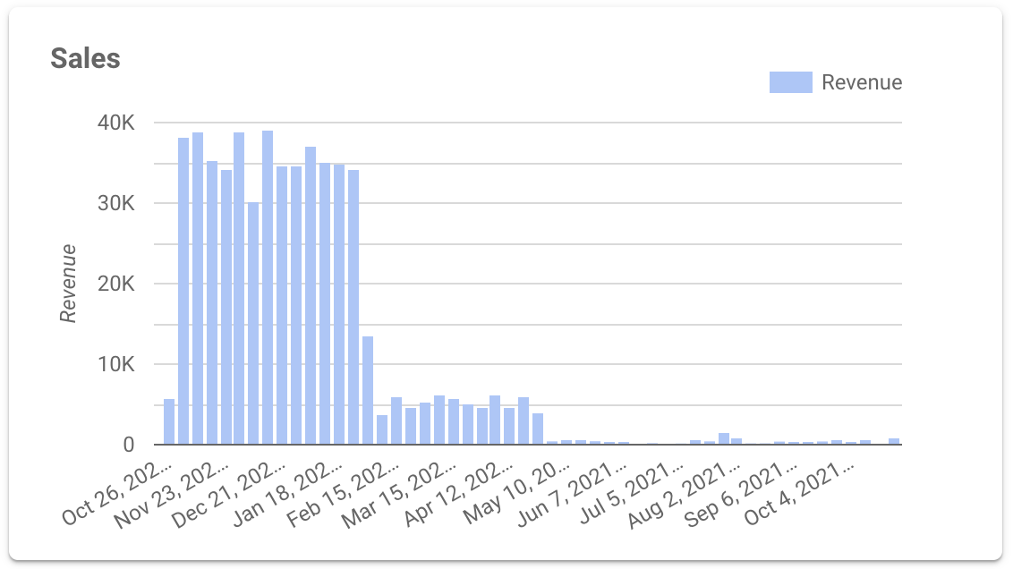
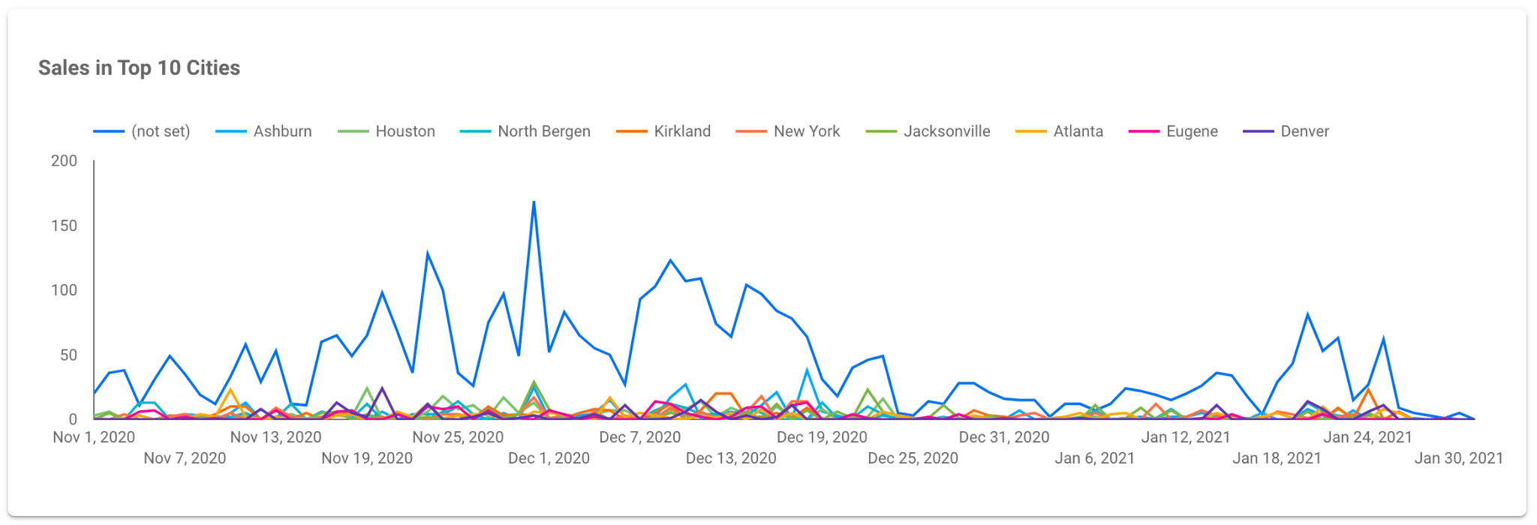
Store performance
Product Availability
Sales
Sales in top 10 cities

Slide 7
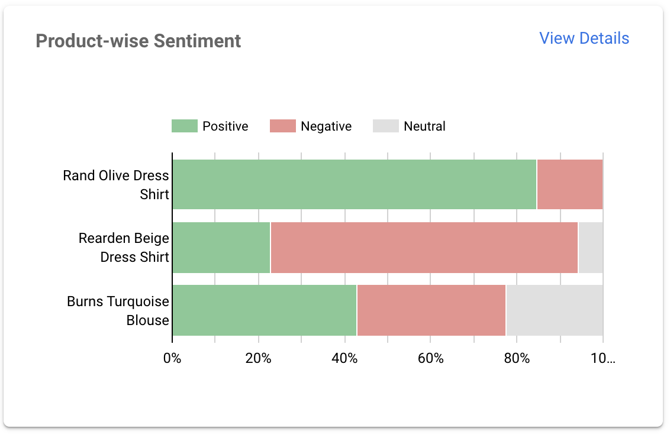
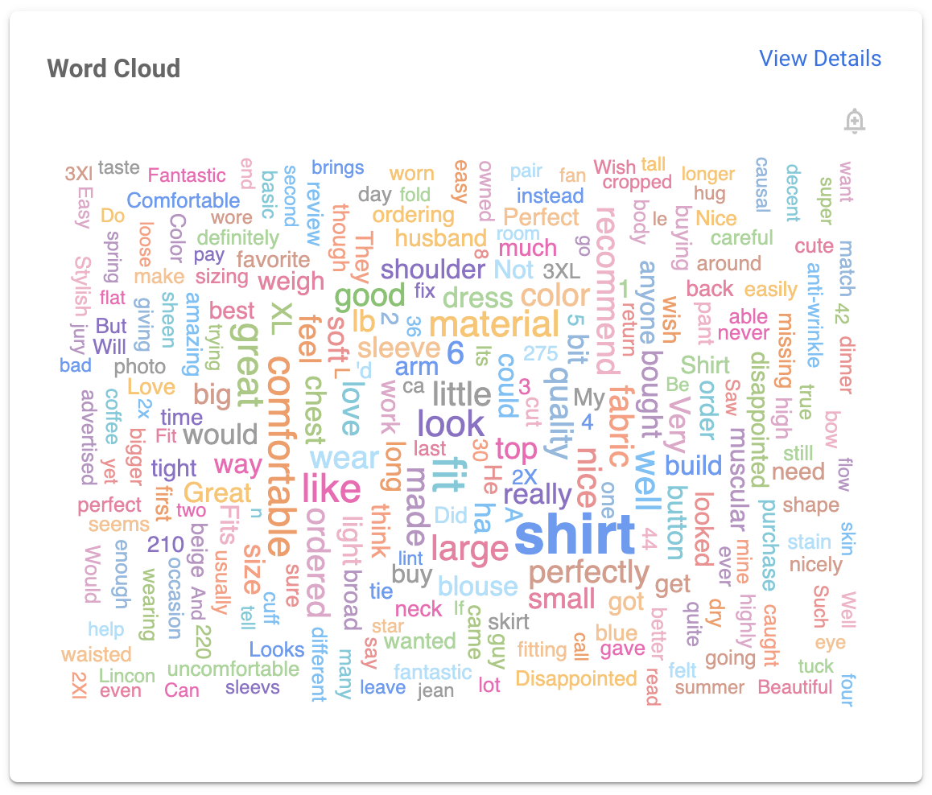
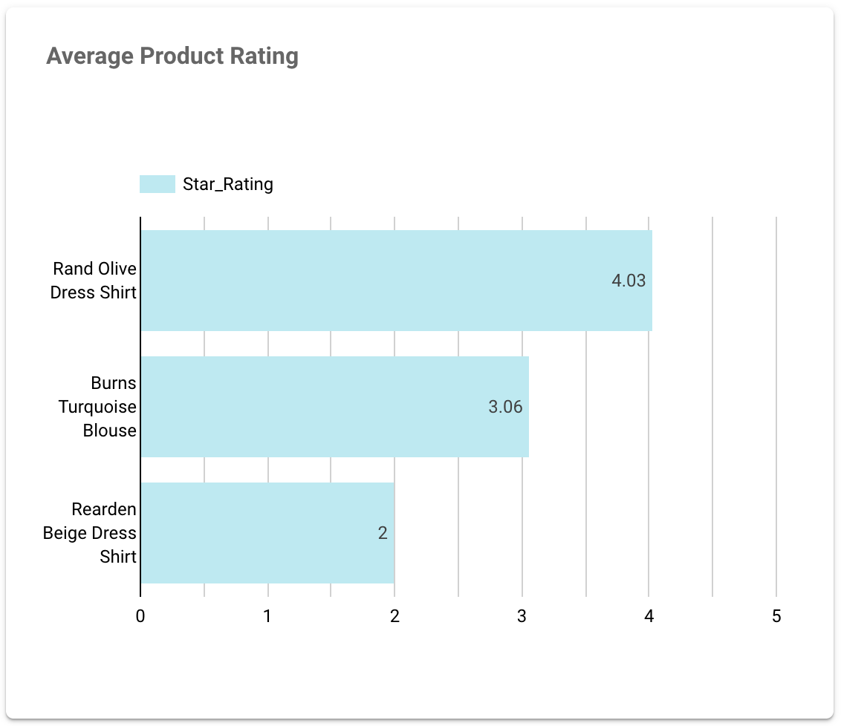
Sentiment analysis
Overall Sentiment
Product-wise Sentiment
Average Product Rating
Word Cloud

Slide 8
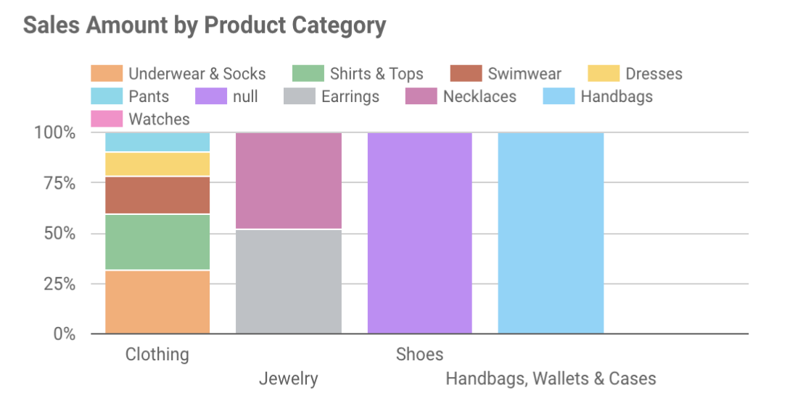
Product Performance
Product Sales by Region
Sales Amount by Product Category

Slide 9

Thank you

